Slide 1


Introduction to Databases
Checkpoint

Slide 2


What’s a Database?
In computing, a database is an organized collection of data stored and accessed electronically from a computer system. Where databases are more complex they are often developed using formal design and modeling techniques.

Slide 3
What are RDBMS?
Stands for "Relational Database Management System." An RDBMS is a DBMS designed specifically for relational databases. Therefore, RDBMSes are a subset of DBMSes.
A relational database refers to a database that stores data in a structured format, using rows and columns. This makes it easy to locate and access specific values within the database. It is "relational" because the values within each table are related to each other. Tables may also be related to other tables. The relational structure makes it possible to run queries across multiple tables at once.

Slide 4

Exemples of RDBMS and their functionalities [1]:
1/MySQL :
MySQL is a relational database management system. This database language is based on the SQL queries to access and manage the records of the table.
Easy to use
MySQL is easy to use. We have to get only the basic knowledge of SQL. We can build and interact with MySQL by using only a few simple SQL statements.
It is secure
MySQL consists of a solid data security layer that protects sensitive data from intruders. Also, passwords are encrypted in MySQL.
Client/ Server Architecture
MySQL follows the working of a client/server architecture. There is a database server (MySQL) and arbitrarily many clients (application programs), which communicate with the server; that is, they can query data, save changes, etc.

Slide 5
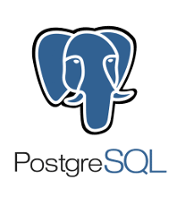
Exemples of RDBMS and their functionalities [2]:
2/PostgreSQL :
PostgreSQL is an ORDBMS [Open-Source Object-Relational Database Management System]. It is used to store data securely; supporting best practices, and allow recovering them when the request is processed.
PostgreSQL will offer us the facility to add custom functions with the help of various programming languages such as Java, C, and C++, etc. PostgreSQL is a powerful, open source object-relational database system that uses and extends the SQL language combined with many features that safely store and scale the most complicated data workloads. PostgreSQL is highly extensible. For example, you can define your own data types, build out custom functions, even write code from different programming languages without recompiling your database. It is a highly stable database management system. PostgreSQL is used as the primary data store or data warehouse for many web, mobile, geospatial, and analytics applications.
The primary objective of PostgreSQL is to handle a variety of jobs from single technologies to web service or the data warehouse with several parallel users.

Slide 6

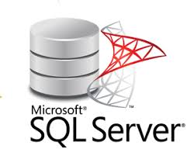
Exemples of RDBMS and their functionalities [3]:
3/SQLServer :
Microsoft developed and marketed the SQL Server relational database management system (RDBMS) to primarily compete with the MySQL and Oracle databases. It is also called MS SQL Server, which is an ORDBMS, platform-dependent, and can work on GUI and command-based software. The key interface tool for SQL Server is SQL Server Management Studio (SSMS), which operates in both 32-bit and 64-bit environments,
Usage of SQL Server: The following are the key usage of MS SQL Server: Its main purpose is to build and maintain databases. It is used to analyze the data using SQL Server Analysis Services (SSAS). It is used to generate reports using SQL Server Reporting Services (SSRS). It is used to perform ETL operations using SQL Server Integration Services (SSIS).

Slide 7
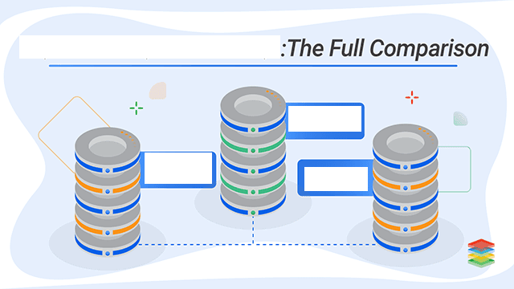
SQL SERVER vs MySQL vs PostgreSQL
MySQL
SQL
SERVER
Postgre
SQL

Slide 8
Name | SQL Server | MySQL | PostgreSQL
Description | Microsofts relational DBMS | Widely used open source RDBMS | Widely used open source RDBMS
Primary database model | Relational DBMS | Relational DBMS | Relational DBMS
Secondary database models | Document store Graph DBMS | Document store | Document store
Developer | Microsoft | oracle | PostgreSQL Global Development Group
Data scheme | yes | yes | yes

Slide 9
Name | Microsoft SQL Server | MySQL | PostgreSQL
License | commercial | Open Source | Open Source
Server-side scripts | Transact SQL, .NET languages, R, Python and (with SQL Server 2019) Java | yes | user defined functions
In-memory capabilities | Yes | Yes | No
SELECT ... | Select [col1], [col2] | SELECT col1, col2 | SELECT col1, col2
Using quotation marks | name = ‘John’ only | name = ‘John’ or name = “John” | name = ‘John’ only

Slide 10
Merci pour votre attention ☺

